Slide 1

TIWGPUBLISHING Pty Ltd

Slide 2
ABOUT US
TiwgPublishing is the Republic Music Publisher and a Record Label company. Our core purpose is to distribute timeless music in the world ,in the music industry and film industry. We are a machine that turns dreams into reality
Record Label and Music Distributor
We are a unique brand because does distribution, management and marketing, sales and PR. That alone makes us the most powerful record label in south Africa that we are able to handle our thing . We are registered with SAMRO, RISA, SOUNDEXCHANGE, CAPASSO and SUGOMUSIC.
We are able to distribute music from south Africa, African countries and to the rest of the world through www.tiwgpublishingmusic.co.za. We are able to provide all resources that are needed to make the artist to be a celebrity and maintain them.

Slide 3
vision
C.A.R.E
CARE ATTENDANCE RESPECT EFFICIENT

Slide 4
MISSION
We CARE for our Artists, we ATTEND fully to our ustomers, we RESPECT our customers and we do our job EFFICIENTLY.

Slide 5
Our core values
International class music standards and care for our own artists and fans
Innovation
Operational Excellence
Perseverance
Trust, respect and honesty

Slide 6
SERVICES offered in Management division
PR
Marketing
Distribution(most platforms)
Branding
Music video (additional service)
Managing bookings
Managing TV and radio interviews
Managing content in all platforms
Managing contracts and recordings
Managing auditions.
Managing tours

Slide 7
Services offered in Recording Label
PR
Marketing
Distribution(all platforms including internationally)
Branding
Music video
Setting up bookings
Setting up TV and radio interviews
Managing content in all platforms
Setting up contracts
Setting up features
production
Recording
Mastering
Song writers
Managing studio time
Set up live performances( TV, Radio and open live shows)
Setting up tours.

Slide 8
Our Partners and sponsors
COMING SOON

Slide 9
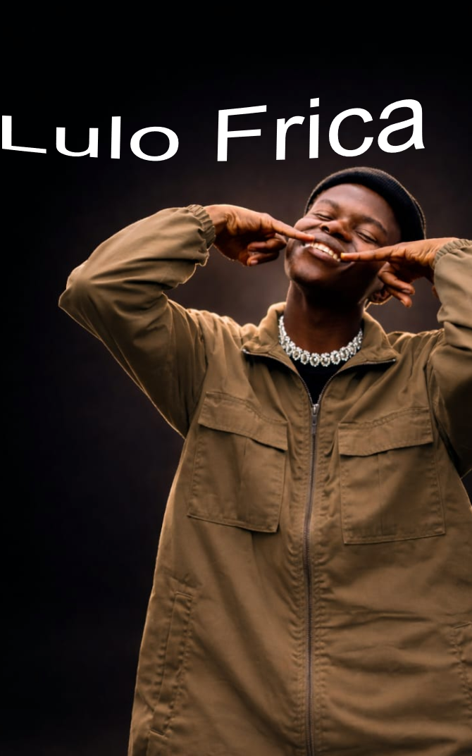
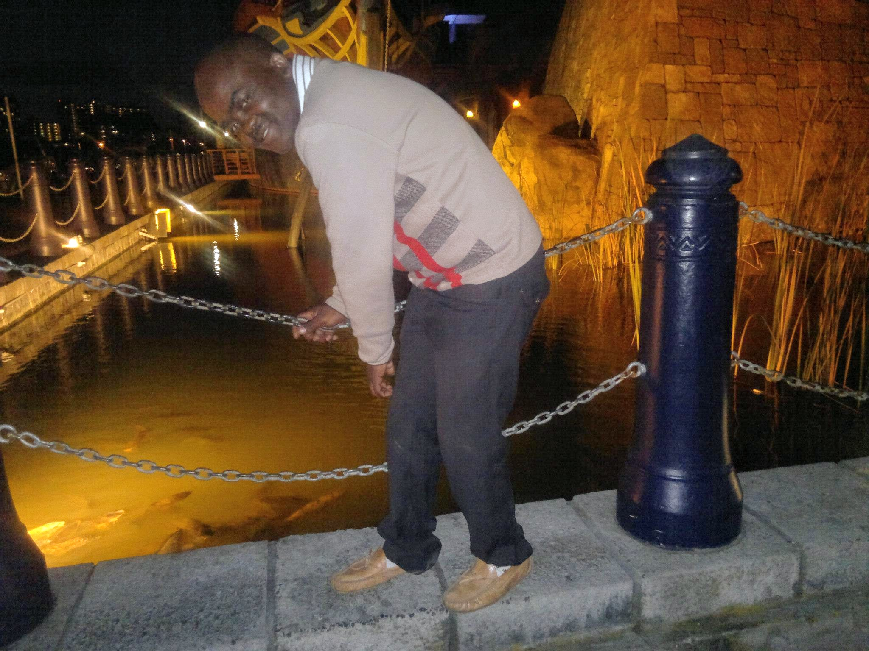

Our Own up coming artist

Slide 10
Why us?
One of the few providers of high quality.
Most competitive innovations and sounds
Professional and integrity
Artists, fan and stakeholders satisfaction is our top priority
Our company aims to build and maintain long life relationships through always exceeding artists and fans expectations.
I have most qualified and experienced team working 24/7
Everything is done in house.

Slide 11
contacts
Head Office
536 D633 off R603
UMBIMBILU
DURBAN
KZN
4105
CEO AND FOUNDER :
MLUNGISI MAKHANYA
MOBILE: 062 574 5381
Email: bavulele67@gmail.com
admin@tiwgpublishingmusic.co.za

